Slide 1

General CE Information

Slide 2
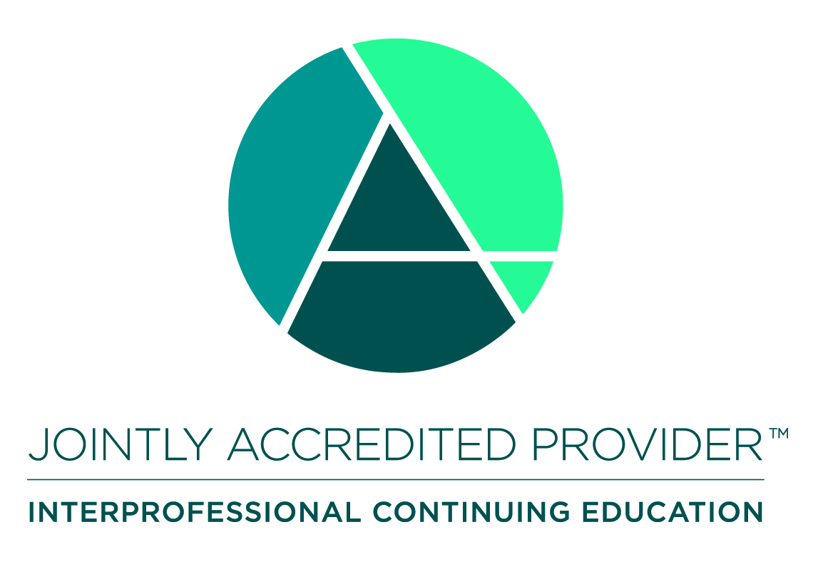
Accreditation Statement
        In support of improving patient care, the National Home Infusion Association (NHIA) is jointly accredited by the Accreditation Council for Continuing Medical Education (ACCME), the Accreditation Council for Pharmacy Education (ACPE), and the American Nurses Credentialing Center (ANCC), to provide continuing education for the healthcare team.

Slide 3
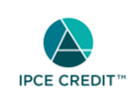



Credit Designations
      This activity was planned by and for the healthcare team, and learners will receive Interprofessional Continuing Education (IPCE) credit for learning and change.
Webinar Title | CE Hrs
Nurse Bytes: Drug Calculations: A Nurse's Guide to Safe Medication Dosing | 0.25
Nurse Necessities: Right Patient, Right Practice: A Nurse's Guide to the Five Rights | 0.50
Nurse Bytes: From Script to Safe: Teaching Patients How to Administer with Care | 0.25

Slide 4
Overview, Target Audience, and Learning Objectives: Nurse Bytes: Drug Calculations: A Nurse’s Guide to Safe Medication Dosing
PURPOSE: This session equips home infusion nurses with the essential skills to accurately calculate IV medication dosages, ensuring safe and effective patient care. Participants will explore best practices for dose verification, infusion rate calculations, and clinical accountability in the home setting.
TARGET AUDIENCE: The professional audience for which this CE activity has been designed includes Pharmacists, Pharmacy Technicians, Nurses, Dietitians and other non-clinical infusion providers.
LEARNING OBJECTIVES: The learning objectives for this activity are as follows:
  Describe best practice for dose verification and infusion rate calculations to ensure safe administration and minimize medication errors in the home setting.
  Apply accurate dosage calculation methods to determine IV medication volumes and infusion rates using standardized formulas and technology.
  Integrate principles of clinical accountability by documenting calculations, validating infusion parameters, and communicating effectively with interdisciplinary teams to uphold patient safety.

Slide 5
Overview, Target Audience, and Learning Objectives: Nurse Necessities: Right Patient, Right Practice: A Nurse’s Guide to the Five Rights
PURPOSE: This session empowers home infusion nurses to apply the Five Rights of medication administration—right patient, drug, dose, route, and time—with precision and accountability. Through practical guidance and real-world scenarios, participants will strengthen their role in ensuring safe, high-quality care during medication preparation and delivery.
TARGET AUDIENCE: The professional audience for which this CE activity has been designed includes Pharmacists, Pharmacy Technicians, Nurses, Dietitians and other non-clinical infusion providers.
LEARNING OBJECTIVES: The learning objectives for this activity are as follows:
  Apply the Five Rights of medication administration to ensure safe and accurate IV medication delivery in the home setting.
  Identify and mitigate common risks associated with medication preparation and administration through scenario-based problem-solving and peer discussion.
  Demonstrate clinical accountability by documenting medication administration accurately and communicating effectively with interdisciplinary teams.

Slide 6
Overview, Target Audience, and Learning Objectives: Nurse Bytes: From Script to Safe: Teaching Patients How to Administer with Care
PURPOSE: This session equips nurses with practical strategies to teach patients safe and effective medication administration, from prescription to practice. Through clear communication, demonstration techniques, and patient engagement tools, participants will learn how to foster confidence and reduce risk in home-based care.
TARGET AUDIENCE: The professional audience for which this CE activity has been designed includes Pharmacists, Pharmacy Technicians, Nurses, Dietitians and other non-clinical infusion providers.
LEARNING OBJECTIVES: The learning objectives for this activity are as follows:
  Describe effective patient education strategies for safe medication administration, including clear verbal instructions, visual aids, and hands-on demonstrations.
  Apply communication techniques that build patient trust, clarify expectations, and address barriers to understanding or adherence.
  Utilize patient engagement tools to reinforce learning, assess comprehension, and promote confidence in self-administering medications at home.

Slide 7
Disclosure of Relevant Financial Relationships
As an accredited provider of continuing education for the healthcare team, NHIA collects disclosure of financial relationships with all ineligible companies, which include manufacturers of drugs, medical equipment, and other products related to patient care. All relevant financial relationships have been mitigated prior to the start of this activity.

Slide 8
Disclosure of Relevant Financial Relationships (continued)
The following are the relevant financial relationships from planners, faculty, reviewers, or other persons that affect the content of this activity:
All persons who affect the content of this webinar have reported no relevant financial relationships.

